Slide 1

GOOGLE MEET
Google Meet is a video conferencing service from Google. It's a great solution for both individuals and businesses to meet on audio and video calls. It was born from Google Hangouts, but boasts some unique features. One of the best things about Google Meet is that you don't need to install any software on desktop. Everyone in the call (the organizer and the attendees) simply has to be using a modern web browser.
By: M. HUSSAIN NATHANI- 25
UJJVAL DUBEY- 74
FYCS

Slide 2
Meet’s Features:
Unlimited number of meetings
Live captioning during meetings
Compatible across devices
Video and audio preview screen
Adjustable layouts and screen settings
Controls for meeting hosts
Screen sharing with participants
Messaging with participants
Integration with Google and Microsoft Office apps

Slide 3
How to access Google Meet:
FROM YOUR COMPUTER:
Use any modern web browser—no download required
You can start a meeting or join a meeting from any modern browser on your desktop or laptop. There’s no additional software to install.
FROM YOUR PHONE OR TABLET:
Download the Google Meet mobile app
Join, host, or share your screen from the Google Meet mobile app. Download from Google Play or Apple Store.

Slide 4
How to sign up for Google Meet:
For personal use:
If you’re already using Gmail, Google Photos, YouTube, or another Google product, just sign in to your existing Google Account.
For business use:
If you're already a Google Workspace user, just sign in to your existing account.
For Google Workspace admin:
Google Meet is already included in Google Workspace and Google Workspace for Education Fundamentals.

Slide 5
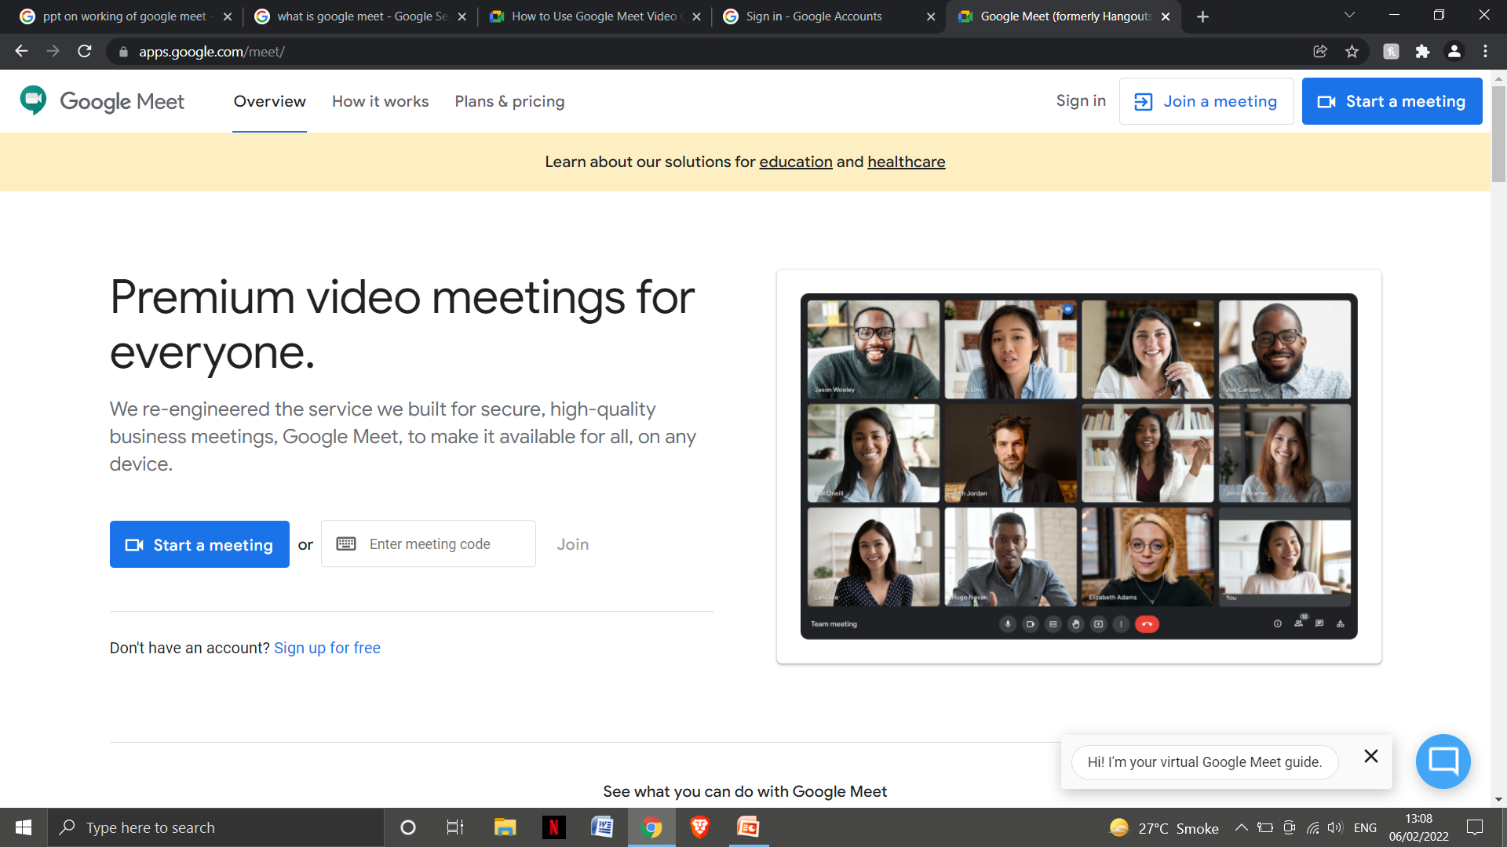
How to start a video meeting:
On Web: https://meet.google.com/

Slide 6
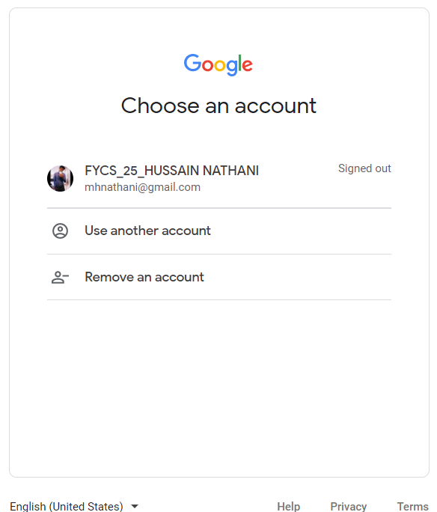
Create a new meeting:
To create a new video meeting, log in to your existing Google Account or sign up for free.

Slide 7
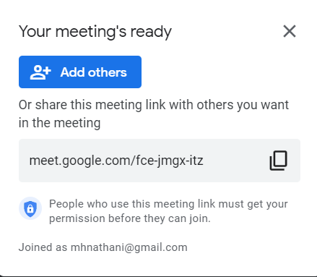
Invite others to your online meeting:
Send a link or meeting code to anyone you want to join the meeting. For the free version of Google Meet, guests will need to create or sign in to an existing Google Account to join.

Slide 8
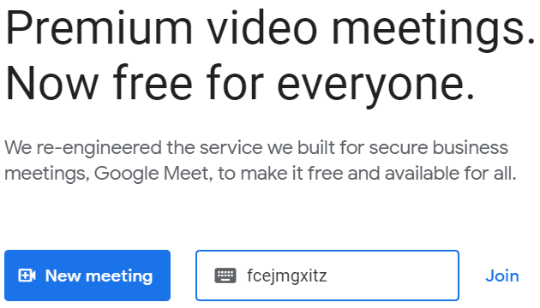
Join a meeting:
Tap the meeting link from the invite, enter the meeting code from your host, or call into the meeting using the dial-in number and PIN in the invite.

Slide 9


